Slide 1
0x10B – Threat Modelling
ECED4406 – Computer Security
Dr. Colin O’Flynn
Dalhousie University.
(NOTE – This slide set is new for 2023. You can see some of this material in slides “0x301” in the old set)

Slide 2
More Reading Reference
These slides are covered in Chapter 1 of “Hardware Hacking Handbook”.

Slide 3
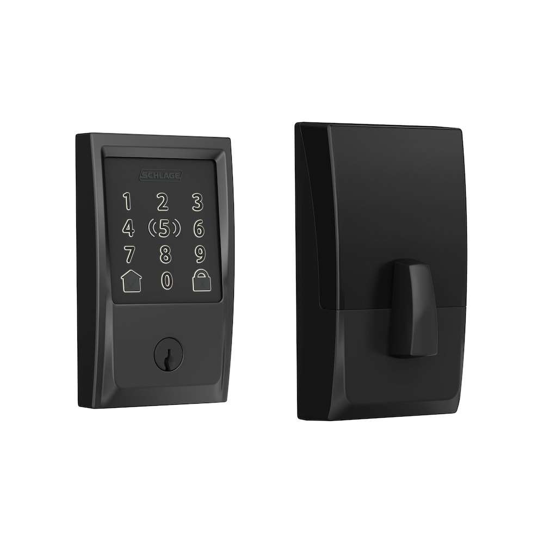
Why Threat Model?
Example: Installing a Door Lock, how secure should it be?

Slide 4
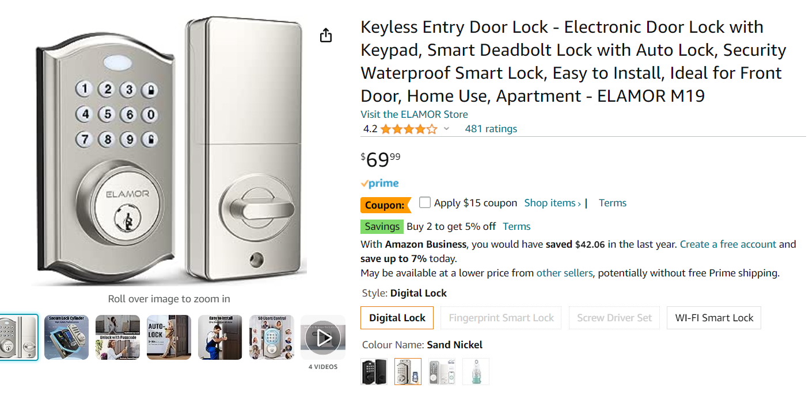
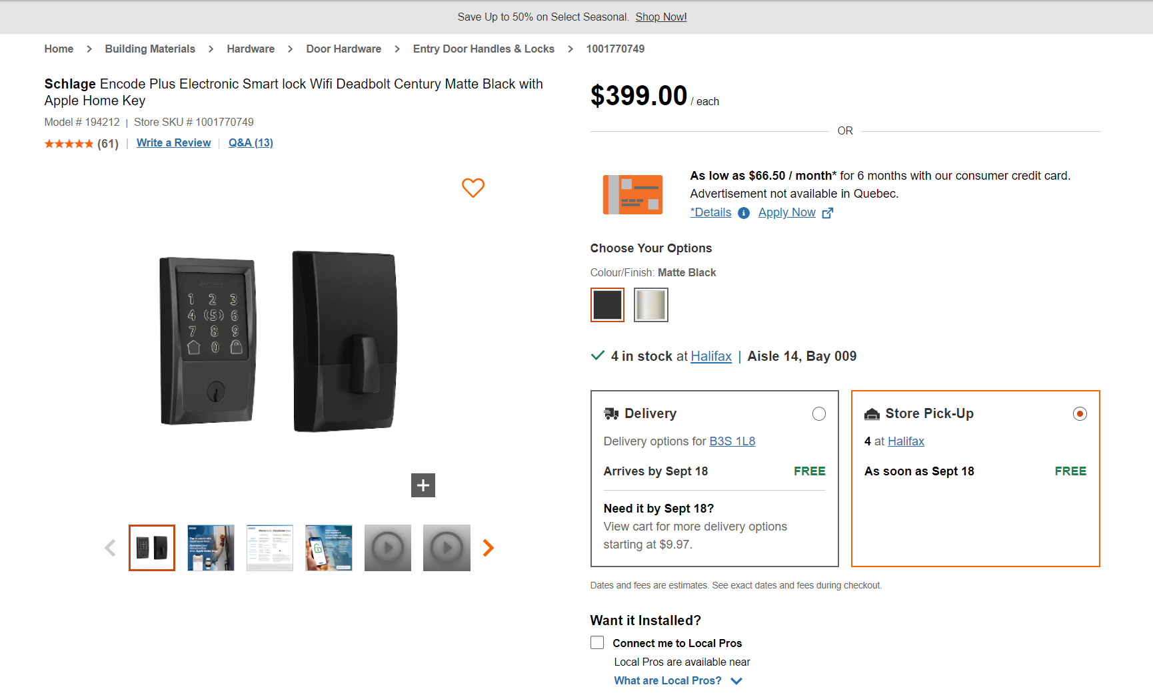
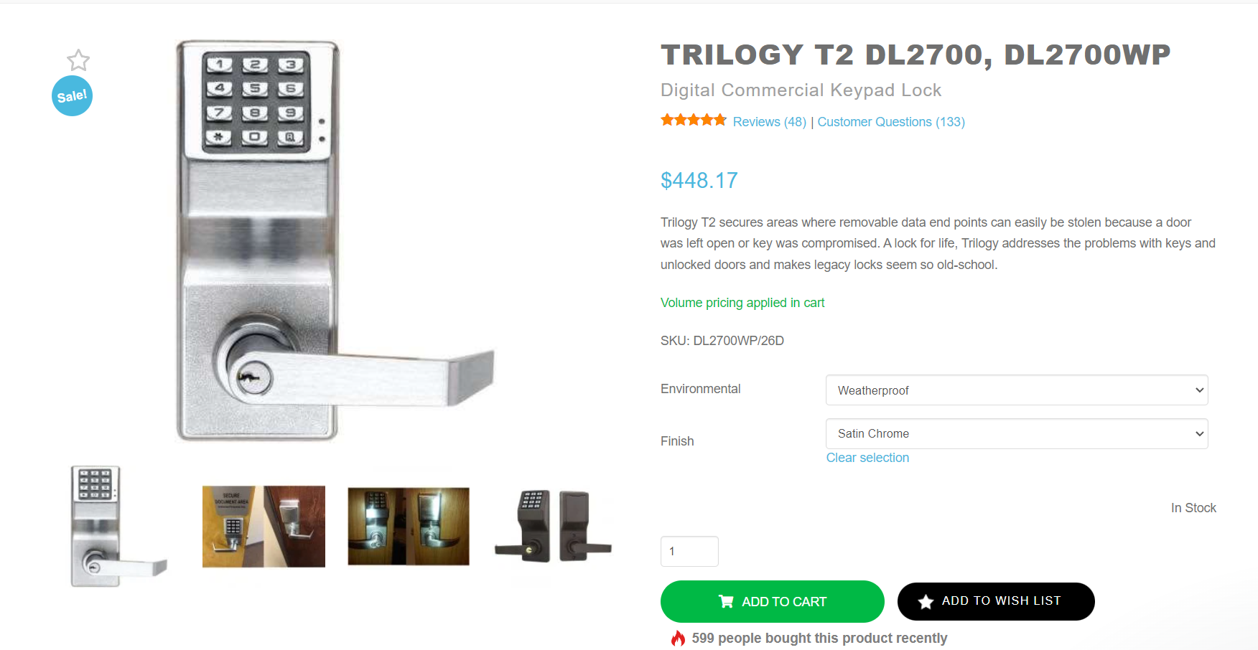
Which lock to choose!?

Slide 5
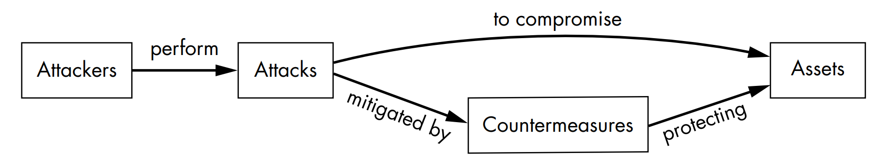
Parts of the Threat Model

Slide 6
Parts of Threat Model: Assets
The end goal of attacks is accessing some sort of asset.
The asset may be obvious or non-obvious, for example:
Credit card data (point of sale terminal).
Access to computer system (ransomware, launching other attacks).
Access to company data (leaking data or IP theft).
Personally Identifiable Information (PII).

Slide 7
Parts of Threat Model: Countermeasures
Countermeasures reduce the likelihood of a given attack being successful. Countermeasures may do any (or all) of the following:
Protect against an attack.
Detect an attack.
Respond to a detected attack.

Slide 8
Parts of Threat Model: Attacks
Attacks are how attackers compromise a system.
Understanding the attacks is a key part of this class (you’ll learn how to apply attacks & what is required for them).
Will need to understand the complexity of attacks.

Slide 9
Parts of Threat Model: Attackers
Attackers are the “bad actors” attacking the system.
Attackers often are rated on their knowledge & access to resources.

Slide 10
Attack Trees
Attackers
In Front of Door
Behind the Door
Rounded boxes indicate the states an attacker is in or assets an attacker has compromised (“nouns”)

Slide 11
Attack Trees
Attackers
In Front of Door
Behind the Door
Pick the Lock
Guess the PIN Code
Steal a key
Kick door in
Turn the handle
Square boxes indicate successful attacks the attacker has performed (“verbs”)
Open Door
Valuables

Slide 12
Attack Trees
Attackers
In Front of Door
Behind the Door
Door Lock
Pick the Lock
Guess the PIN Code
Steal a key
Kick door in
Turn the handle
Open Door
Dashed lines/arrows indicated countermeasures.
Valuables

Slide 13
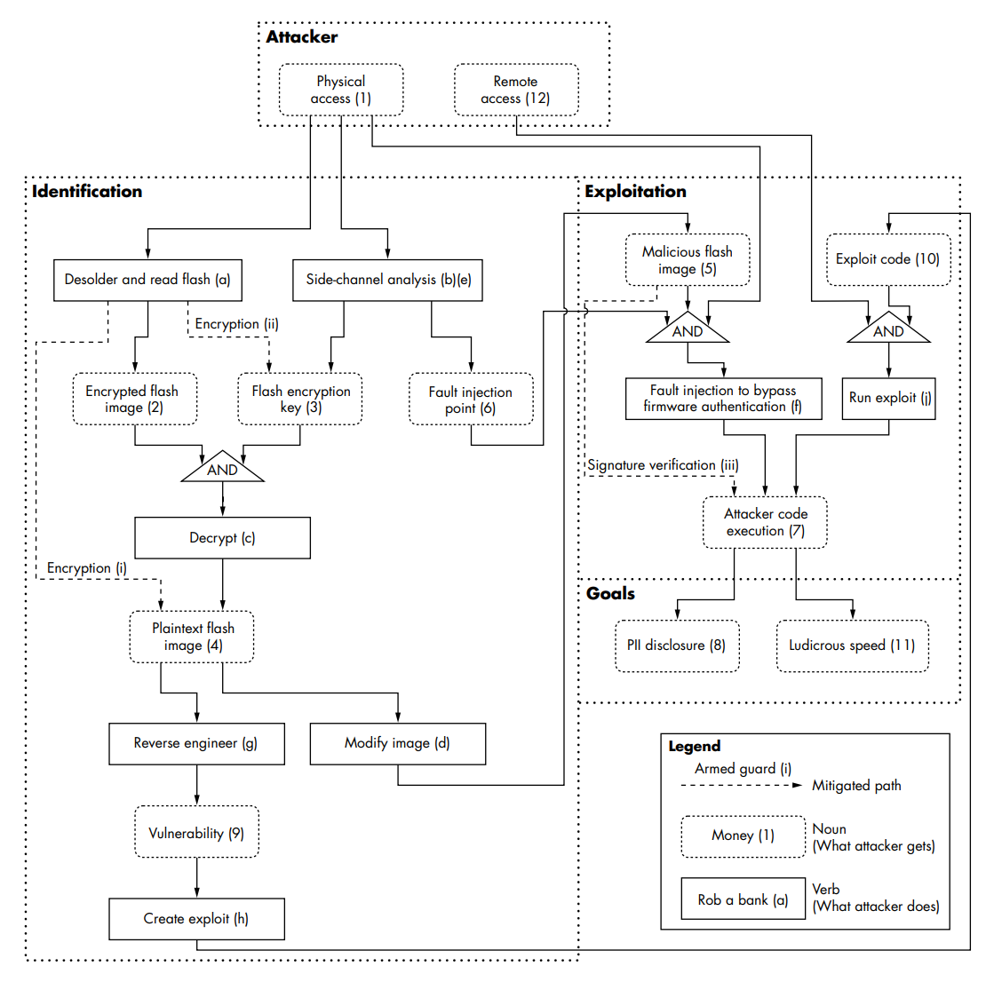
More complex example (Figure 1-12 in book).
Shows how you can have both an Identification phase & an Exploit phase.

Slide 14
Scoring Attack Paths
Attacks are often scored based on:
Cost/Complexity of Identification Phase
Cost/Complexity of Exploit Phase
Impact of attack (may depend on usage)
Access level required by attack
Scalability

Slide 15
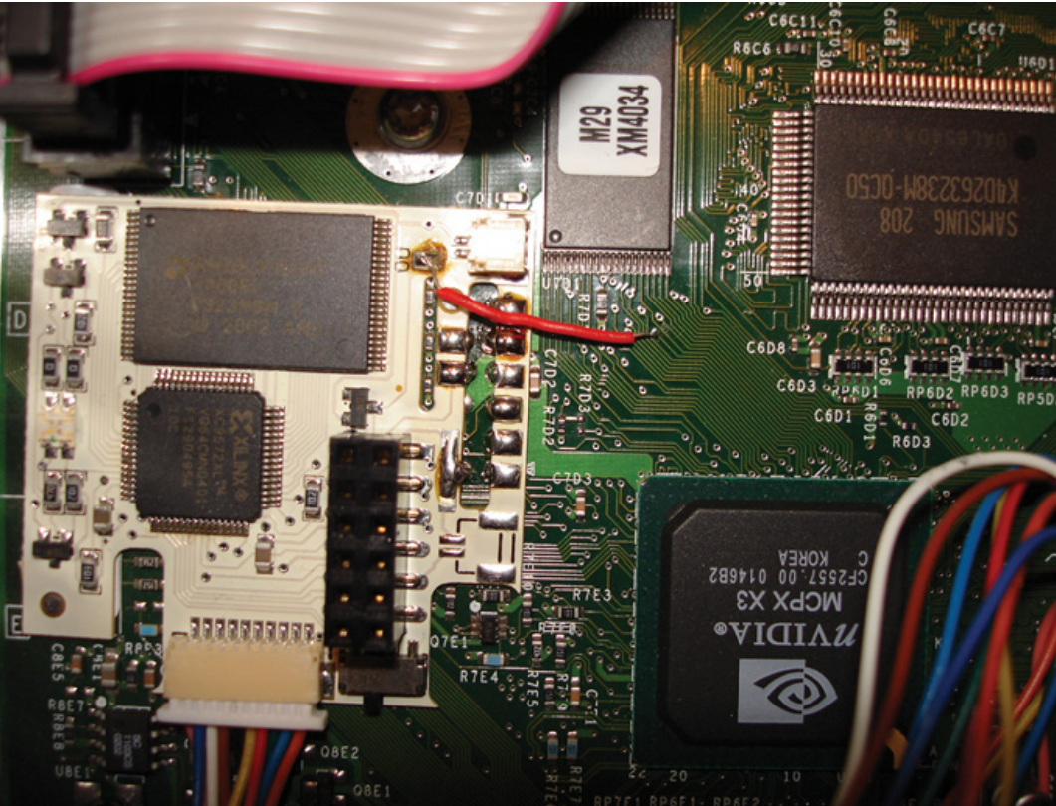
Scalability?
Scalable attacks can be replicated by less sophisticated attackers.
In many cases these are packaged & sold.
E.g., Console modchips (photo to right)
E.g., automotive theft tools (https://www.vice.com/en/article/7kz48x/guy-selling-relay-attack-keyless-repeaters-to-steal-cars )

Slide 16
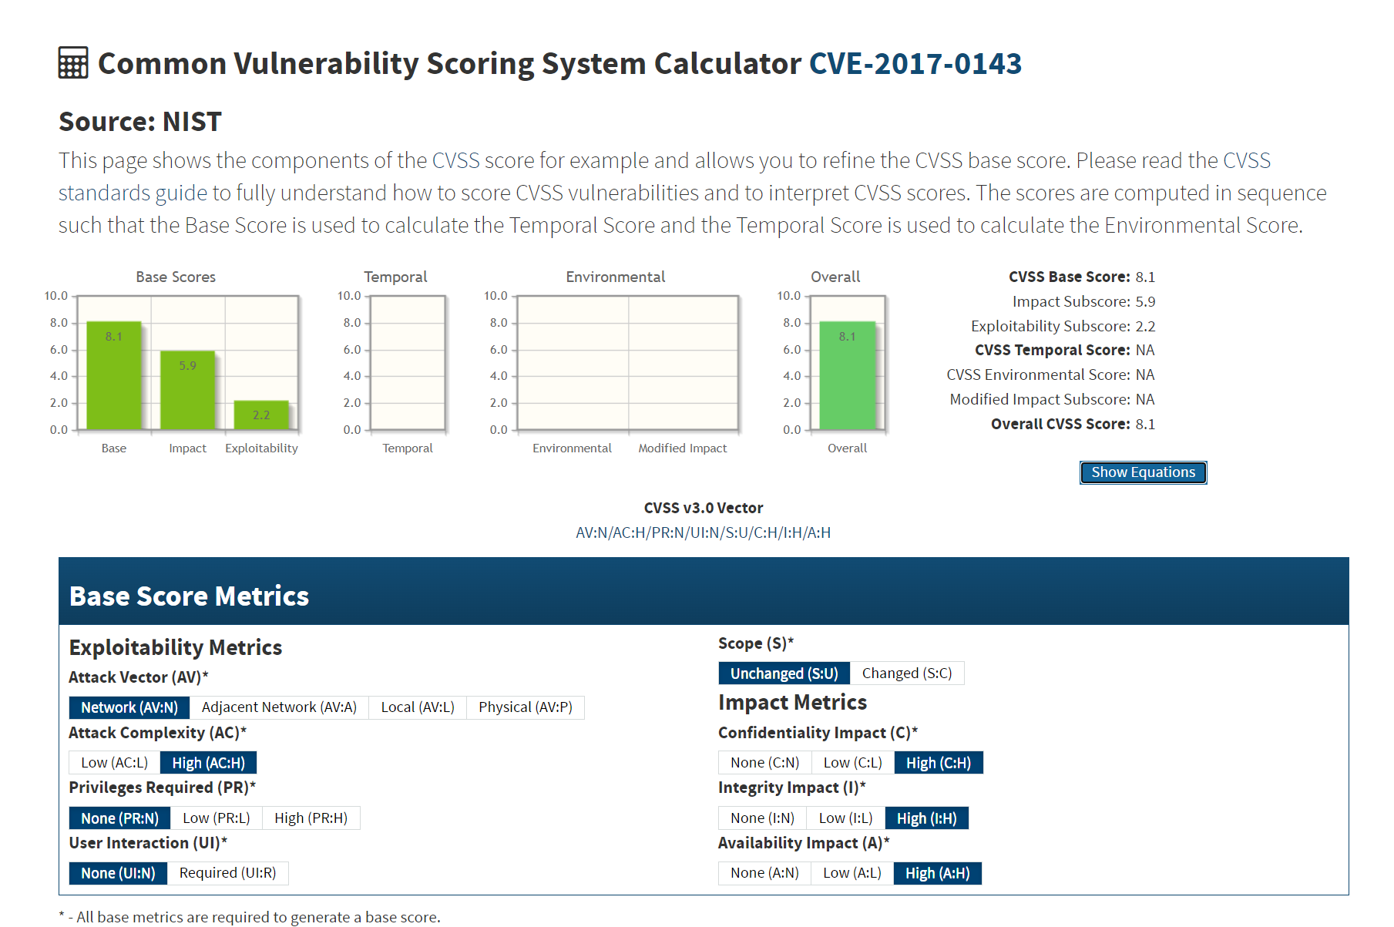
Threat Scoring
Normally there is some “number” assigned to a given threat. For example:
CVEs (Common Vulnerabilities and Exposures) have a CVSS (Common Vulnerability Scoring System)
E.G, let's look at https://nvd.nist.gov/vuln/detail/CVE-2017-0143
(WannaCry ransomware attack from 2017)
Focus mostly on the base scores for the next part…

Slide 17
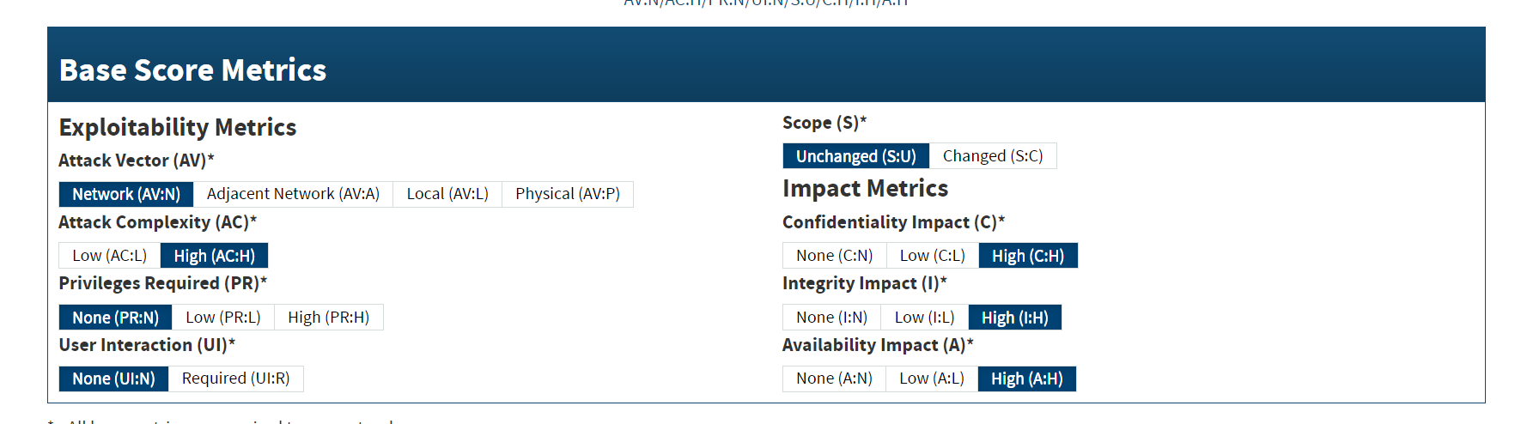
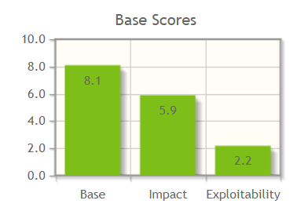
Scoring Method - CVSS

Slide 18
Threat Models in Industry
Threat models often matched with a protection profile, which specifies certain features a given device needs to have to protect against expected threats.
In embedded systems, you can see examples of these in the Arm Platform Security Architecture (PSA) Level 1 / 2 certifications.
They originated from higher-security assurance level system used for credit cards, satellite TV cards, etc.

Slide 19
Summary
Threat modelling may require some off-the-wall thinking to cover every possible threat.
Need to track countermeasures that exist within the system.
Can split it into both an identification & exploitation phase in more complex attacks.
Variety of industry-specific scoring methods, all generally use a similar idea of ranking difficulty of attack, impact, and how easy/scalable attack is.

